Slide 1
SPARK A Messaging Application

Slide 2
Problem Statement
The messaging application, in which I am demonstrating a facility where we can store the chat history of the conversation.
Basic features are : Create user account, Send messages, View chat history.

Slide 3
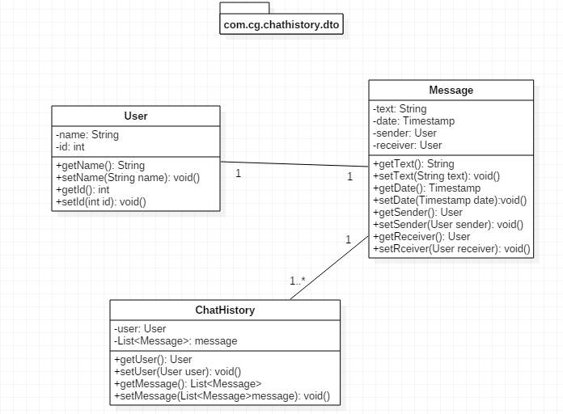
POJO Classes

Slide 4
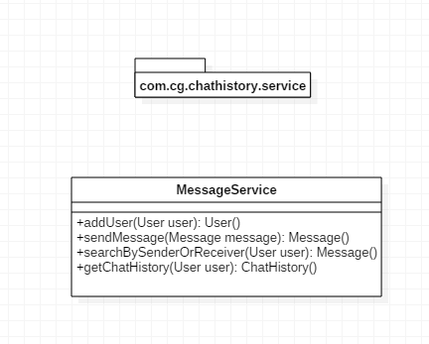
Service

Slide 5
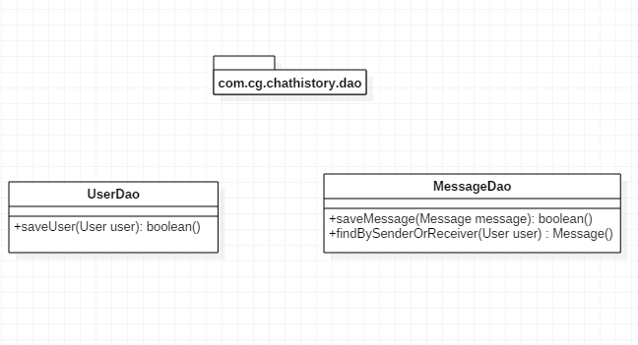
Dao

Slide 6
Thank You

